Slide 1


Mobile Cloud

Slide 2
What is Mobile Cloud?
Mobile Cloud Computing (MCC) integrates mobile devices with cloud services. This offers key benefits over traditional mobile computing. These benefits include increased processing power and storage. It also improves scalability and accessibility. MCC empowers modern mobile experiences.

Slide 3
Comparison between
Mobile Computing and
Mobile Cloud Computing

Slide 4
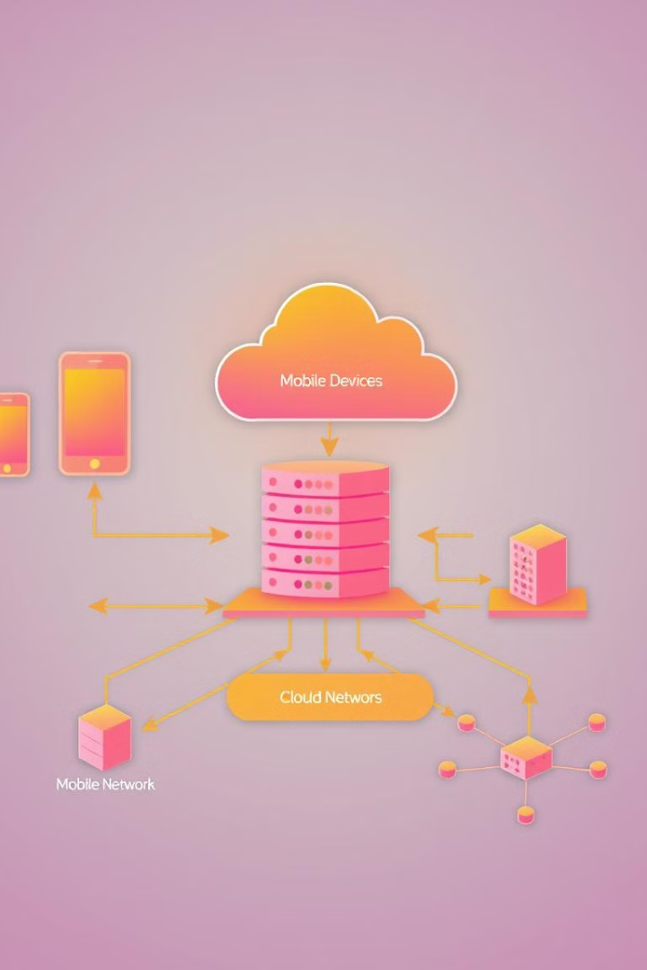
Architecture of Mobile Cloud
MCC relies on mobile devices, cloud infrastructure, and a robust mobile network. Data flows seamlessly within this architecture. Different deployment models cater to varying needs. These models are public, private, and hybrid. Each offers unique benefits and security profiles.

Slide 5

Benefits of Mobile Cloud Computing
Increased battery life. Cloud handles intensive tasks.
Enhanced data capabilities. Access to vast cloud storage.
Improved scalability. Resources adjust to demand.
Cost savings. Reduced infrastructure investment.

Slide 6




Applications of Mobile Cloud
Mobile Gaming
Healthcare
Education
Business
Cloud rendering delivers high-end graphics.
Remote monitoring improves patient care.
Cloud resources enable flexible learning.
Mobile CRM streamlines business processes.

Slide 7

Challenges of Mobile Cloud
Security and privacy remain key concerns. Network latency and bandwidth issues can hinder performance. Data synchronization requires careful planning. Finally, vendor lock-in poses interoperability risks.

Slide 8

Future Trends in Mobile Cloud
Expect Edge Computing integration. This lowers latency for critical apps. AI and machine learning will drive smarter services. 5G adoption enhances MCC capabilities. Increased focus on robust security solutions is crucial.

Slide 9

Conclusion: The Future is Mobile and in the Cloud
Mobile Cloud Computing offers immense potential. It transforms industries and enhances user experiences. Embrace MCC for competitive advantage. Unlock innovation through cloud-powered mobility.

Slide 10
Thank you!

